Slide 1
Walmart Retail Dataset Analysis

Slide 3
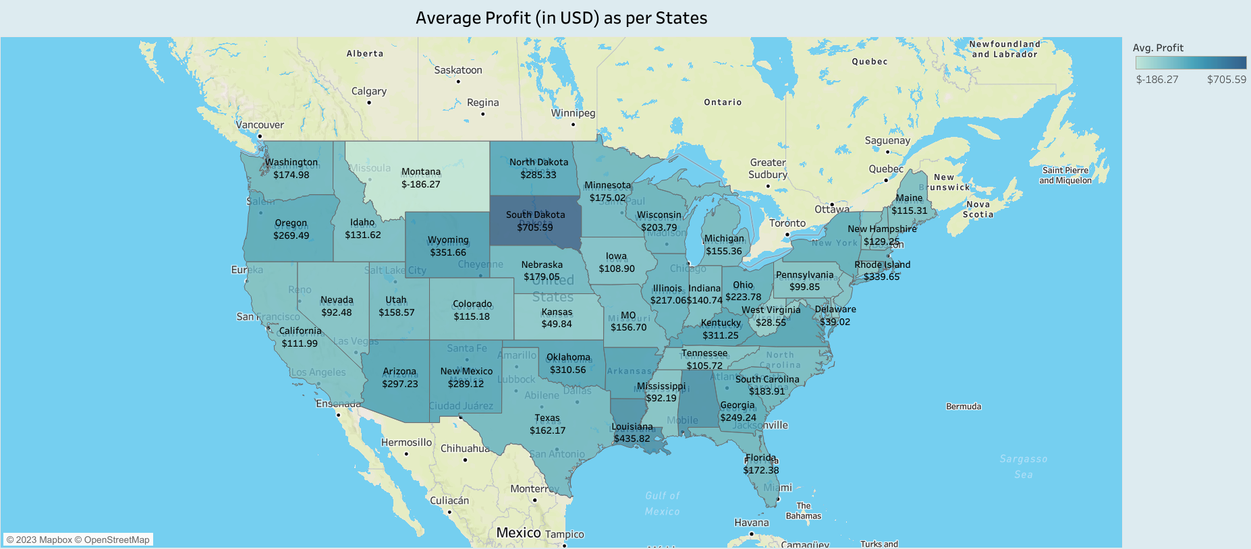

Slide 4
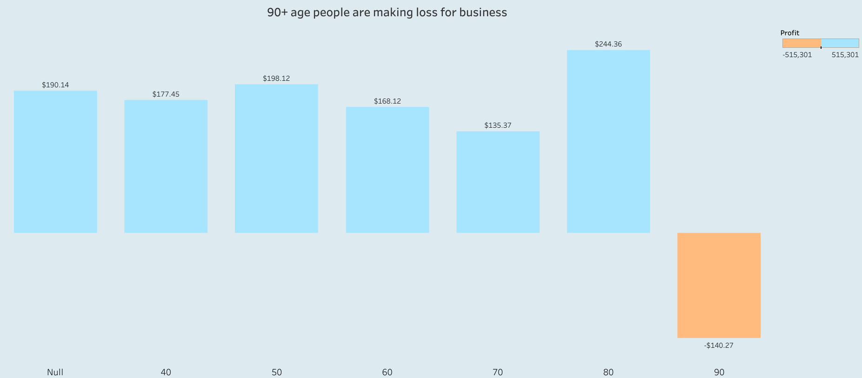

Slide 5


Slide 6
